Slide 1

Asymptotic Analysis
CISC 610
Data Structures & Algorithms

Slide 2
What are we doing today?
Background
Data Structures
Algorithms
What is Recursion?
Iteration versus Recursion
Head Recursion versus Tail Recursion
Pseudo-Code for Fun & Profit
Algorithmic Efficiency
Asymptotic Notation

Slide 3
Data Structures & Algorithms
Data Structure
How we store information with the goal of accessing and processing that information
A data structure can have a unique configuration, ordering, interface, behavior, some of the above, all of the above, or something else
How data is stored affects what we can do with it and how it can be done
Not all data storage paradigms are equally efficient

Slide 4
Data Structures & Algorithms
Algorithm
A sequential set of instructions to execute a particular task
(A recipe for getting something done)
Helps break down complex tasks into smaller steps
Top-down development or stepwise refinement
Algorithms help us solve specific problems
Not all algorithms are equally effective
Some algorithms require certain prerequisite conditions
Some algorithms can only be run on certain data structures

Slide 5
Data Structures & Algorithms: An Analogy
Have you heard the saying “When you have a hammer, everything looks like a nail?”
What does it mean?
Sometimes, being given a tool primes you for a given activity
e.g. Give someone a hammer, they’ll want to smack everything like it’s a nail
Data structures are the hammer, algorithms are how you swing it
Not all hammers are right for every job
Not every job requires a Donkey Kong-level hammer swing
But certain hammers and swings go better together than others

Slide 6
Matching Data Structures & Algorithms
What makes for a good match?
Compatibility
Some data structures and algorithms are structurally incompatible
Ease of implementation
Some algorithms are much harder on the coder to implement on specific data structures
Efficiency
Some algorithms will leverage the inherent structure of information to be more efficient

Slide 7
Algorithm Efficiency
Okay, so what do we mean by “an efficient algorithm?”
All instructions should be completable in a finite amount of time
(More about this next class)
…In a perfect world, execution time would be near-minimized
Memory consumption should also be near minimized
(Although, let’s be honest, memory usage is not always the limiting factor it was even 20 years ago)
It should be as specific as possible
Instructions should be unambiguous
Necessary inputs would be clear and outputs useful

Slide 8
Classes of Algorithms
Algorithms can be groups into classes by general approach
These approaches may be defined by how the algorithm is created, how it processes data, or classes of problem where it can be used
Some examples:
Greedy
Go for the best thing you can right now and hope that it works out long term
Example: Making change

Slide 9
Classes of Algorithms
Some examples:
Divide and conquer
Splits the data into sub-groupings and tries to solve on those sub-groupings
Works well with “fractal” data structures and recursive approaches
Structures where a sub-aspect of the structure could be considered a complete structure in its own right
Example: Lists/Dynamic arrays

Slide 10
Classes of Algorithms
Some examples:
Dynamic programming
Like divide and conquer, problems are divided into sub-problems
Unlike divide and conquer, these sub-problems overlap
(The sub-problems in divide and conquer are disjoint)
Dynamic programming uses the knowledge within these overlaps to help optimize performance
Example: Matrix chain multiplication
(Look, none of these algorithms are “simple”…)

Slide 11
Classes of Algorithms
Some examples:
Brute force algorithm
Also called combinatorial approaches
Tries every combination of a solution
Example: Traveling Salesman
Branch and bound
Branches a problem out by incremental choices
At each branch, the potential outcome is compared to a maximum or minimum bound and then branches are pruned
Example: Minimax trees in zero-sum games

Slide 12
Let’s Talk about Recursion! ©
What is recursion?
See: recursion
A function that calls itself
Composed of two elements, determined by an if statement:
Base case
The most basic/simple/elemental condition for the function
Recursive case
Case where the function calls itself
The recursive call must move towards the base state
Functions can sometimes have multiple base or recursive cases

Slide 13
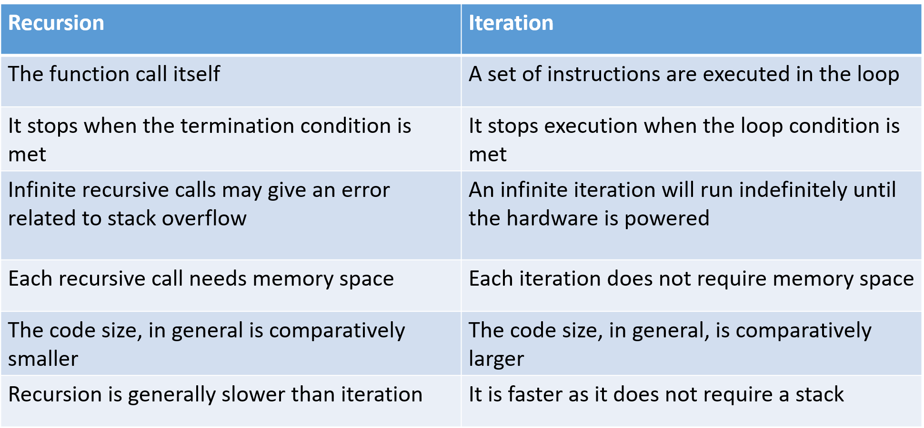
Let’s Talk about Recursion! ©
What’s the difference between recursion and iteration?
Remember: ANYTHING you can do with one, you can do with the other!

Slide 14
Let’s Talk about Recursion! ©
What’s the difference between recursion and iteration?
Why is recursion slower?
You return contexts from the call stack for each function call!

Slide 15
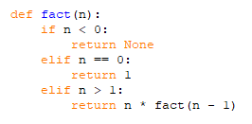
Let’s Talk about Recursion! ©
Let’s do the classic example:
Let’s define a recursive function for a factorial
5! = 5 × 4 × 3 × 2 × 1 and 0! = 1
This traditional approach can be called “linear recursion”
Because our recursive calls do not branch

Slide 16
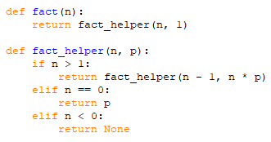
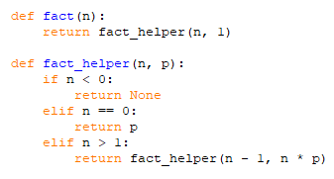
Let’s Talk about Recursion! ©
Tail
Okay, but are there different types of linear recursion?
Let’s consider where the call occurs in the function
Head
First, both of these approaches use a recursive helper function
But WHERE in the function does the call occur?

Slide 17
Head & Tail Recursion
So what’s the big deal?
In this case, none
But what if we printed in our recursive cases?
Head recursion has recursive call first
Tail recursion has recursive call last
What would happen to our output order?
This order will affect any calculation
But let’s take a look tail recursion…
Could we optimize it’s overall performance?
(Do we need to return contexts?)

Slide 18
Tail Elimination
A compiler/interpreter optimization for tail recursion
What happens when you restore the context to tail recursive calls?
Variables are restored from the call stack and then we return
Why do we need to restore context then?
We don’t
Because the work is done when we reach the base case, the compiler simply “free-falls” return data back to the initial context
Not all compiler, interpreters, or languages support this
For instance…Python (*sad trombone noises*)

Slide 19
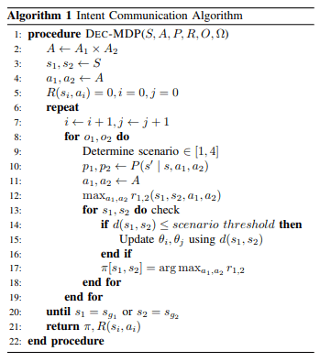
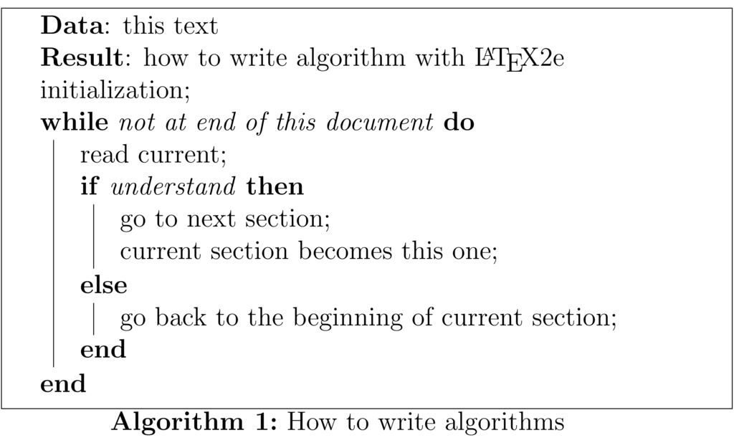
Pseudo-Code
A mix of high-level/human readable language and code
No real standard to what it looks like and no fixed syntax
Used for algorithm design
Can be very mathematical or written in natural languages

Slide 20
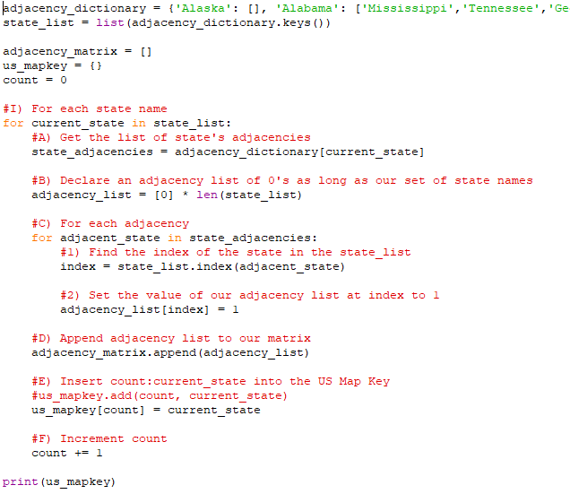
Pseudo-Code
Pro-tip!
Design your algorithm in pseudo-code in your IDE
Then code around it!
Serves as a guide for your development
Code really is self-documenting
This is Professor Grey’s style. Do with it what you will…

Slide 21
Algorithm Efficiency
Remember, we want efficient algorithms
What does this mean?
Code that doesn’t take too use up too much memory or take too much time to run
How do we compare these metrics for different algorithms?
Space is easy as we can track the number of bytes allocated in memory for all values, even temporary values
And for time we could just clock the run, right?
If it’s good enough for Usain Bolt…

Slide 22
Algorithm Efficiency
What problems could we encounter using this method?
What if we run the same algorithm on two different computers?
What if we run an old implementation on a new computer?
We get around this by considering and counting the “operation”
Definition can be a little amorphous and change by language
Generally a single, atomic unit of computation
Assigning a value to memory, doing a simple calculation, checking a condition, etc.
As we’ll see, as long as our scale is consistent, our exact definition of an “operation” is immaterial!

Slide 23

How to Count Operations
Process the section of code as the interpreter/RTE would
For each line, you must determine two things
How many operations that line will take to run one time
How many times that line will be run
Multiply those two values together and you get the total run time for that line
Continue for each line in algorithm/code
Add them all up at the end and this is your equation for the total operations
⸫Our operation count is $n^{3}+3n^{2}+5n+6$

Slide 24
Different Measure
What did that capture?
Our worst case operation count
Analysis of every state being adjacent to every state
Represents the maximum execution time/operation count
We could also examine a best case
Every state is Hawai’i/no states are adjacent

Slide 25

Different Measure
What did that capture?
Our worst case operation count
Analysis of every state being adjacent to every state
Represents the maximum execution time/operation count
We could also examine a best case
Every state is Hawai’i/no states are adjacent
Our operation count is $n^{2}+6n+6$
Represents the maximum execution time/operation count

Slide 26
Different Measure
What did that capture?
Or we could look at an average case
All states are adjacent to an “average number” of states
25? That actual average? Up to you
We could run the numbers again but this will represent the theoretical average run time
But isn’t this process, in a technical sense, a pain in the butt?

Slide 27
Asymptotic Analysis
Measures the comparative number of operations as the input size gets big
Like “infinitely big” big
From the mathematical concept of an asymptote
A line that continually approaches a given curve but does not meet it at any finite distance
The idea is to encapsulate and describe how an algorithm grows and scales

Slide 28

Asymptotic Notations
We will be using Big-O notation
Big-O notation is a tight upper bound on an algorithms run time
Can be used as an best, average, or worst case run times
Example: Sequential search is $O(1)$ in the best case, $O(n)$ in the average case, and $O(n)$ in the worst case
But what does this mean?
That the most significant term of the operation count function has a variable quantity of $n$
As $n$ grows infinitely large, $n$ the number of operations will grow according to some linear equation

Slide 29

Asymptotic Notations
We will be using Big-O notation
Conceptually, we are ignoring all terms except for the most significant and all coefficients
The algorithm with an operation count of $n^{3}+3n^{2}+5n+6$ is $O(n^{3})$
This is why we don’t care if a particular instruction is 1 or 7 operations
Those are all $O(1)$!

Slide 30
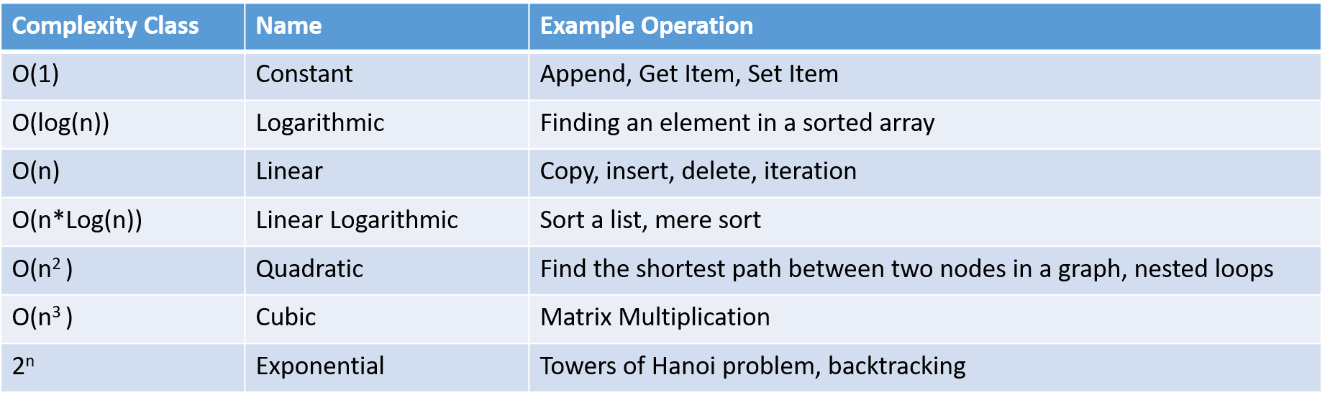
Complexity Classes
Classifications of asymptotic notation that are considered roughly equivalent
The following is not an exhaustive table but a decent guide
Also: https://www.bigocheatsheet.com/

Slide 31
Questions?

